Slide 1
TRANSDERMAL DRUG DELIVERY SYSTEMS
by
A. S. Adebayo, PhD

Slide 2
Introduction
Transdermal drug delivery systems (TDDS) are dosage forms designed to facilitate the passage of therapeutic quantities of drug substances through the skin and into the general circulation for systemic effects.

Slide 3
Skin Structure
The epidermis –almost impermeable, dead layer of cells. It controls the percutaneous absorption of drugs and other chemical agents.
The dermis –matrix of connective tissue made up of fibrous proteins (collagen, elastin, reticulin) embedded in mucopolysaccharide.
It also contains nerves, blood vessels and lymphatic vessels and appendages such as sweat glands.
Branches from arterial plexus deliver blood to sweat glands, hair follicles, subcutaneous fat and the dermis.

Slide 4
Drug transport through the Skin
The epidermis is very selective and it provides major control for the permeation of the skin.
Drug entry into the skin can occur through three possible routes:
Through the hair follicles
Via the sweat duct
Across the stratum corneum.

Slide 5
Factors Affecting Percutaneous Drug Absorption
Concentration of drug – The amount of drug absorbed per unit surface area per time increases with increase in concentration of drug in the TDDS.
Surface area of application – More drug is absorbed from TDDS with larger size.
Affinity of drug for skin and for the base – Physicochemical attraction of drug should be higher for the skin than for the base. PC should be adequate
Molecular weight of the drug – Drugs of molecular weight (MW) between 100 & 800 can permeate the skin provided the lipid solubility is adequate. The ideal molecular size of drugs for TDDS is 100 – 400.

Slide 6
Partition coefficient of drug
Compounds with partition coefficients indicating an ability to dissolve in both oil and water (i.e. log P of 1–3) would permeate the skin relatively rapidly.

Slide 7
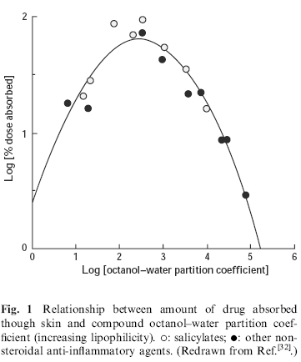

Slide 8
Factors Affecting Percutaneous Drug Absorption
Hydration of the skin – The skin should be adequately hydrated for efficient drug absorption from TDDS.
Site of application – Better delivery is achieved when TDDS is applied to site with thin horny layer (see below)
Duration of application – The longer the medicated application remains on, the greater the total drug absorbed.

Slide 9
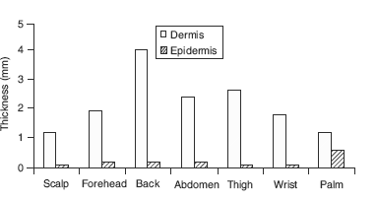
Varying skin thicknesses at different body regions.

Slide 10
Formulation of TDDS
The main components of TDDS are:
The drug
The base/delivery device
The Percutaneous absorption enhancers.

Slide 11
Drugs in TDDS
Examples of drugs meeting the criteria for delivery in TDDS are:
1) Clonidine Catapress®-TTS – Four layered patch for antihypertensive delivery of clonidine over 7 days
2) Estradiol - Estraderm® (Norvatis) – Four-layered patch and Vivelle® (Norvatis) – three-layered patch. Both are designed to release 17β-estradiol continuously.
3) Nicotine - Habitrol® (Norvatis consumer)- Multilayered patch for controlling nicotine dependence.

Slide 12
Delivery Devices
These are also known as “transdermal patches”
Designed to support the passage of drug substances from the surface of the skin through its various layers into the systemic circulation.
The two most common types are the:
monolithic systems
membrane controlled TDS.

Slide 13
Monolithic systems
Monolithic systems – The design incorporates a drug matrix layer between the device backing and the frontal layers.
The polymer matrix controls the rate at which the drug is released for percutaneous absorption.

Slide 14
Membrane controlled systems
Membrane controlled systems – Designed to contain:
a drug reservoir or “pouch” usually in liquid or gel form
a rate controlling membrane
a backing, adhesive and protecting layers.

Slide 15
Membrane controlled systems .. Cont.
These systems may be prepared by:
pre-constructing the delivery unit, filling in the drug reservoir and sealing
OR
a process of lamination, which involves a continuous process of construction, dosing and sealing.

Slide 16
Advantages of TDDS
Avoidance of gastrointestinal absorption difficulties caused by pH, enzyme and drug interaction with food, etc.
Suitable in cases where oral route is not appropriate as in vomiting/diarrhea
Avoidance of the first pass metabolism in the liver.
Avoidance of the inconveniences of parenteral therapy
Improved patient compliance due to the lower frequency of dosing.

Slide 17
Disadvantages of TDDS
Only relatively potent drugs can be so formulated
Incidence of contact dermatitis has been reported in some patients

Slide 18
Percutaneous absorption Enhancers
Chemical enhancers – Agents which reversibly alter the physico-chemical nature of the stratum corneum to reduce its diffusional resistance
dimethyl acetamide
dimethyl formamide
dimethyl sulfoxide
Ethanol
oleic acid
polyethylene glycols
propylene glycol
sodium laurylsulphate.

Slide 19
New Enhancers
Over the past 2 decades, several chemical skin permeation enhancers have been designed, synthesized, and evaluated:
Azone (1-dodecylazacycloheptan-2-one)
SEPA (2-n-nonyl-1,3-dioxolane)
1-[2-(decylthio]ethyl)azacyclopentan-2-one (HPE-101)
4-decyloxazolid-2-one(DermacTM SR-38)
dodecyl-N,N-dimethylamino isopropionate (DDAIP, NexACT 88)

Slide 20
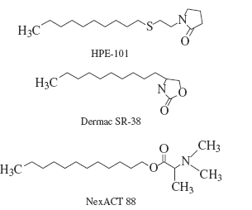
Structures of the skin permeation enhancers HPE-101, Dermac SR-38 NexACT 88

Slide 21
ADVERSE LOCAL REACTIONS AND STRATEGIES FOR REDUCTION
Adverse skin responses to chemical exposure are variable:
may be immediate or delayed
Long or short duration.
Irritant or allergic.

Slide 22
ADVERSE LOCAL REACTIONS AND STRATEGIES FOR REDUCTION …
Dermatological and transdermal formulations contain a complex mixture of active and inactive ingredients
adverse reactions may be due to a formulation additive (excipient) and not necessarily an active compound.
it is well known that the pressure sensitive adhesive used to produce intimate contact with the skin is more often the source of cutaneous reactivity & not the drug.
many of the inactive ingredients used in topical pharmaceutical dosage forms have the ability to alter the barrier function of the skin

Slide 23
Mitigating adverse local reaction
Plant extracts reputed to possess anti-irritant properties and have been recommended for use in cosmetic formulations:
Tea tree oil
Borage seed oil
Paraguay tea extract
Kola nut extract
Oil of rosemary
Lavender oil.

Slide 24
Mitigating adverse local reaction …
Strontium nitrate (Cosmederm-7TM)
reduce the sensory irritation and erythema produced following application of a 70% free glycolic acid peel & histamine-induced itch
A combination of compounds (oleic acid, a short chain length alcohol, and a glycol, all gelled with a carbomer), has been found to reduce chemical-induced inflammation associated with the topical application of several (CELLEDIRM, Cellegy Pharmaceuticals, Inc.).

Slide 25
Percutaneous absorption Enhancers (Cont.)
Ionophoresis – Delivery of charged compounds across the skin membrane using applied electrical field. E.g.
Lindocaine
Dexamethasone
Insulin
verapamil
propranolol.

Slide 26
Percutaneous absorption Enhancers (Cont.)
Sonophoresis – Use of High frequency ultrasound to enhance transdermal drug delivery.
Therapeutic frequency ultrasound (1–3MHz) is most commonly used at intensity in the range of 0–2W/cm².
Therapeutic ultrasound has been attempted to enhance transdermal transport of more than 15 drugs

Slide 27
Mechanisms of sonophoretic transport
Cavitation
Acoustic streaming around the skin
Electroporation
Thermoporation

Slide 28
Mechanisms of sonophoretic transport
Ultrasound exposure in the therapeutic range causes cavitation in the keratinocytes of the stratum corneum.
Oscillations of the ultrasound-induced cavitation bubbles near the keratinocyte-lipid bilayer interfaces & may, in turn, cause oscillations in the lipid bilayers, causing structural disorder of the SC lipids
Shock waves generated by the collapse of cavitation bubbles at the interfaces may also contribute to the structure-disordering effect.

Slide 29
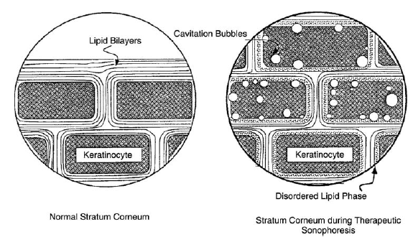
Ultrasound-induced cavitation bubbles in stratum corneum, (Mitragotri, 2007)

Slide 30
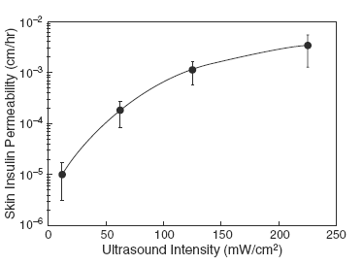
Human skin permeability to insulin

Slide 31
Agents for application of sonophoresis
steroidal anti-inflammatory drugs
hydrocortisone,
dexamethasone
non-steroidal anti-inflammatory drugs such as salicylates and ibuprofen
anesthetic agents such as lidocaine
proteins such as insulin.

Slide 32
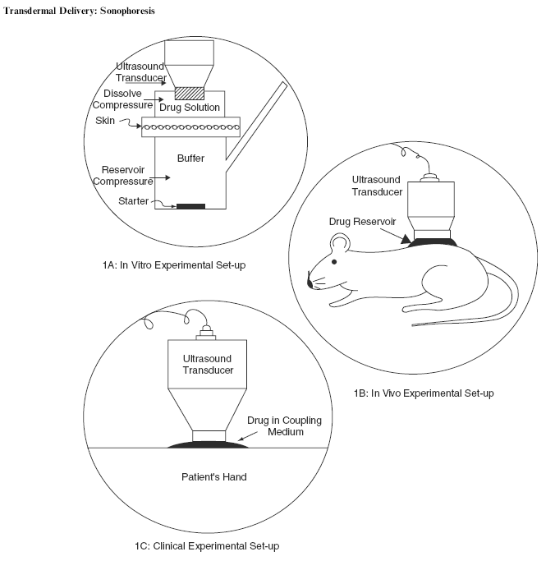
Experimental set-up for sonophoresis delivery

Slide 33
TRANSDERMAL DRUG DELIVERY SYSTEMS
THANK YOU FOR YOUR ATTENTION

